Slide 1
Keine Kompromisse -
Identity Security ohne Grenzen
Frank Weisel
Regional Sales Manager Nord, Silverfort

Slide 2





NHI as Vector for Breaches
(2020)
(2022)
(2023)
(2024)
“78% of organizations are not confident in their ability to block malicious access carried out with a compromised service account.”
“Only 5.7% of organizations believe that they have full visibility into service accounts in their environment.”
„Machine accounts are a significant source of risk (well, many of us knew that...), AND: machine accounts are a significant vector for breaches, TODAY.“
„……..I hope this will open more eyes to the importance of machine IAM and increase the priority and urgency of it.“
Osterman Research, The State of the Identity Attack Surface 2023
Gartner, Felix Gaehtgens, Vice President, Analyst, IAM, August 2024

Slide 3
Security Blind Spots
Active Directory security gaps
Lack of visibility, vulnerable protocols, bad configurations, risky accounts, etc.
Systems that don’t support MFA
Legacy systems, Command-Line Interfaces (e.g. PsExec), IT/OT infrastructure and more.
Non-human Identities
Very difficult to map them, understand where they are being used, and protect them at scale.
Ineffective controls for privileged access
PAM is complex to implement and to use, expensive, and easily bypassed by admins and attackers.

Slide 4




NHI Blind Spots
Non-human identities are especially difficult to protect
Password rotation (PAM) at scale takes years & causes operational disruptions
Highly privileged
Can cause large damage when compromised
Difficult to Protect
Rotating their passwords often breaks applications
Unknown Dependencies
Companies don’t know all service accounts
Regularly Abused
Often used outside of their intended purpose
“We are 2 years into our PAM and password rotation journey, and only 10% deployed”
– CISO, large US-based insurance company

Slide 5

Non-Human Identities (NHI)
Non-human account
Communication and interaction
between systems, or services
Representing the identity and
authorization of an application or
service

Slide 6




MFA Blind Spots
Many sensitive resources still rely on vulnerable authentication protocols & legacy IAM infrastructure like Active Directory, which doesn’t support MFA
Command-Line Tools
(e.g. PsExec, PowerShell, SSH, RDP, WMI, Run As)
Admin Consoles
(e.g. vCenter, monitoring tools, backup, storage)
File Systems and Databases
(e.g. CIFS, SQL)
Legacy Applications
(homegrown or 3rd party)
Network Devices
(e.g. firewalls, routers, switches)
OT and Air-Gapped
Environments
82% of ransomware attacks are exploiting this identity security gap to spread.
Tougher cyber insurance requirements and regulations now require MFA for these systems

Slide 7




The Privileged Access Blind Spot
Although many companies use traditional PAM solutions, attackers continue to compromise privileged accounts, due to major limitations that leave those accounts exposed to compromise
The limitation of traditional PAM that organizations need to overcome:
Slow and complex onboarding
Only 10% of organizations get their PAM project to the finish line*
Discovery
gaps
It’s difficult to identify all privileged users, and where they are being used
Bypassing the PAM
Admins often check-out credentials and access the servers directly
Privileged access abuse
Admins use their privileged accounts to perform other tasks
* Based on a survey of 650 identity leaders, conducted in collaboration with Osterman Research

Slide 8
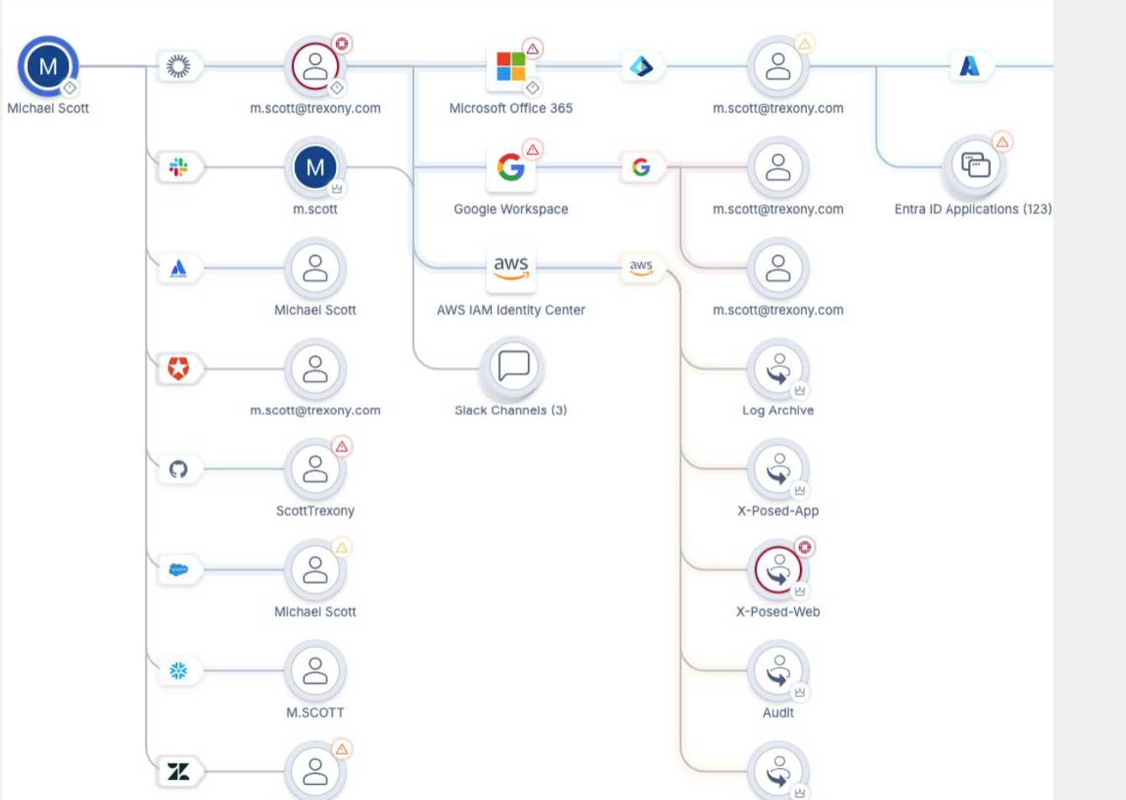
All Environments
Cloud Native Non-Human Identity (NHI)
    Visibility across boundaries Cloud/On-prem
Identity Security Posture Management (ISPM)
Identity Threat Detection and Response (ITDR)
Access and Entitlements Analysis
Example: Mapping the different identities of the same user across all IAM silos, with a unified access graph, and mitigating security exposures.

Slide 9






Runtime Access Protection (RAP) – a security layer behind your existing IAM infrastructure
How Does It Work?
Access Requests
(Kerberos, LDAP/S, NTLM, SAML, OIDC, RADIUS)
1
1
All Identities
(users, service accounts, etc.)
5
5
All Resources
(on-prem & cloud)
Existing IAM Infrastructure
(AD, ADFS, Entra, Okta,
Ping, RADIUS, etc.)
            Step by Step
        User requests access from the IAM infrastructure
        IAM infrastructure forwards the message to the Identity Security Platform using Runtime Access Protection (RAP)
        The platform analyzes the message, detects threats, and determines policy
        If needed, security controls are enforced inline (MFA, Just-In-Time access, Virtual Fencing, etc.)
        If approved, the response message is returned to the IAM infrastructure and then to the unaware client/server
2
5
4
3
MFA and other security controls (including any third-party providers)
Identity Security Platform

Slide 10

Fragen?
Vielen Dank!
Frank Weisel
Regional Sales Manager Nord, Silverfort
frank.weisel@silverfort.com
Fragen Sie eine Demo an: www.silverfort.com/request-a-demo
Confidential

