Slide 1
From Complexity to clarity
Understanding your Software Product Health
Jan-Niclas Strüwer
jan-niclas.struewer@iem.fraunhofer.de
/struewer

Slide 2
Software Development is Complex
How can you measure and communicate this complexity?

Slide 3
Software Development is Complex
How can you measure and communicate this complexity?

Slide 4
Software Development is Complex
How can you measure and communicate this complexity?
One Software Product Health Score for a clear communication

Slide 5
Software Development is Complex
How can you measure and communicate this complexity?

Slide 6
Keeping track of your software product health is cumbersome
Companies face various challenges when assessing and communicating software product health
Often cumbersome and manual process
The current state of your software product depends on a multitude of product specific factors and is often assessed manually
Communication of software product health
Creating a bigger picture from the results of expert tools and communicating it to (non-technical) stakeholders is difficult
Communicating it to all relevant stakeholders is just as difficult
Informed management decisions lead to better prioritization of development tasks

Slide 7
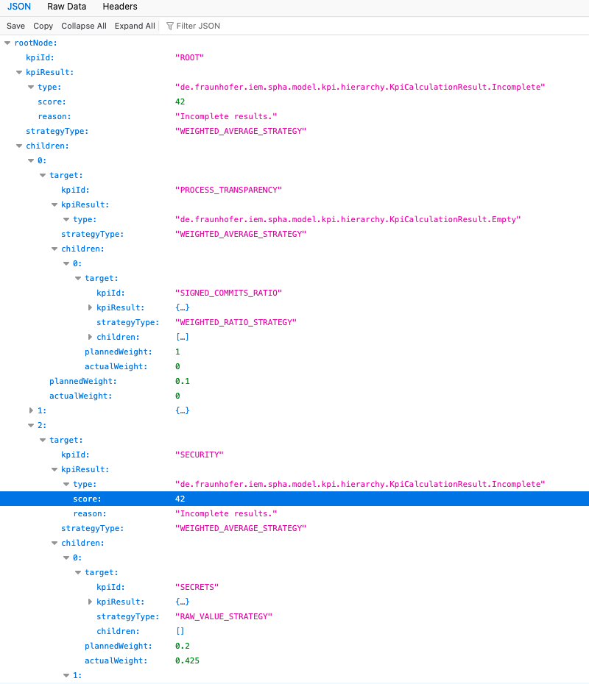
SPHA’s GitHub Action
Automate
github.com/fraunhofer-iem/spha
7
© Heinz Nixdorf Institut / Fraunhofer IEM
Notes:
Which static analysis tools do you already use?

Slide 8
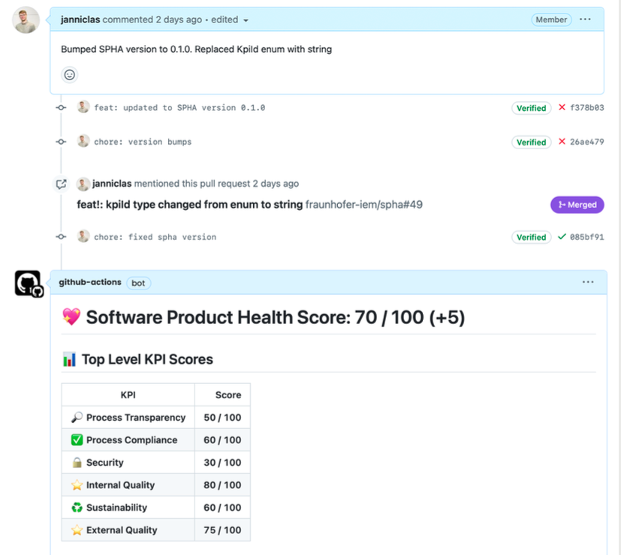
SPHA’s GitHub Action
Communicate
github.com/fraunhofer-iem/spha
8
© Heinz Nixdorf Institut / Fraunhofer IEM
Notes:
Which static analysis tools do you already use?

Slide 9
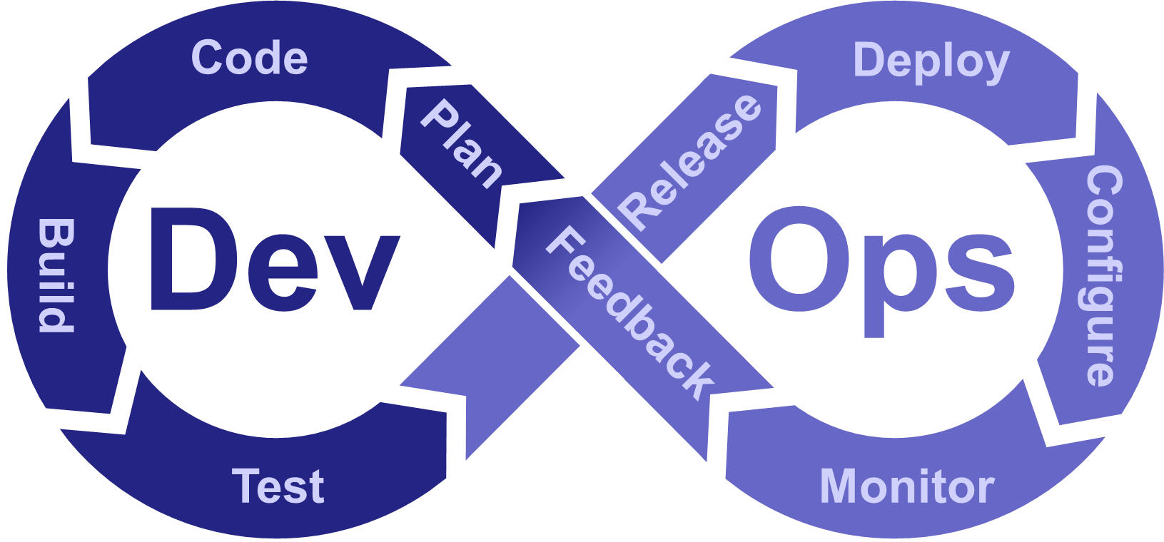
Calculate Software Product Health for the given KPI hierarchy
Assessment & Communication of Software Product Security
Utilizing data from existing & established tools
Transform data into SPHA’s KPI format
Collect data from dev process
with focus on existing tools

Slide 10
Six Aspects of Software Product Health
Security
Sustainability
Internal Quality
Compliance
External Quality
Traceability

Slide 11
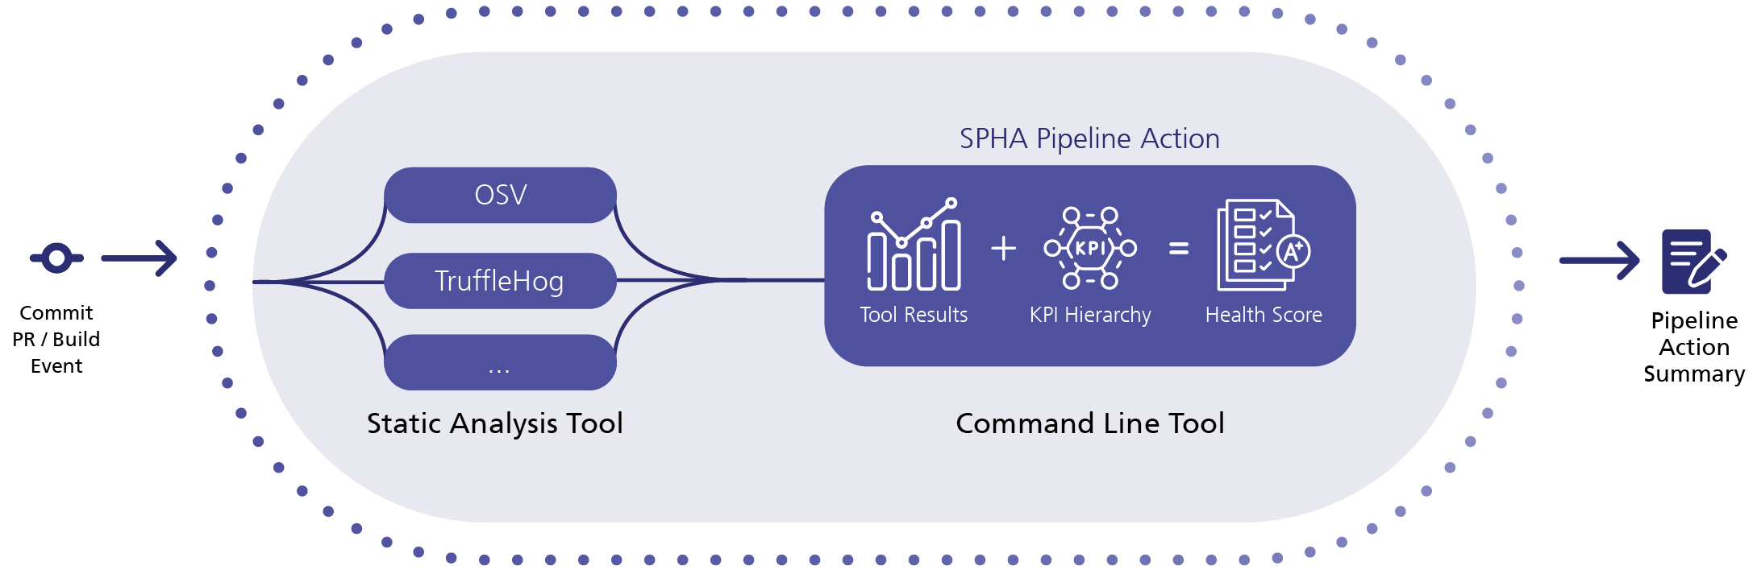
SPHA is a Framework
Customize
Customization is Key
SPHA is a framework that can be used for everything and nothing it all depends on the configured hierarchy, edge weights, and the connected data sources
Notes:
SPHA can be used for everything and nothing it all depends on the configured hierarchy and weights and the connected data sources.
In the following, I’ll give an overview of challenges and corresponding data sources and show you how to model this in SPHA to overcome them

Slide 12
Architectural, threat informed data flow information give context for vulnerabilities
Include data from all phases of the development process
Vulnerabilities
Threat Model
SPHA’s strength is to combine data from different tools in all phases of the development process

Slide 13
Vulnerability Management
A practical example
Detect
Assess
Prioritize
Fix
Vulnerability scanners find vulnerabilities in code, configurations, and deployments
Assess the relevance, impact and risk associated to each vulnerability
Assign priorities and plan when to fix them
Remediate the vulnerability or accept the risk and move on
Tasks
Notes:
Code integrity refers to the assurance that the code has not been tampered with or altered by an unauthorized individual. Evaluating code integrity can be challenging, particularly for larger projects that receive hundreds of commits daily from numerous contributors.
Vulnerability management is the process of continuously identifying, assessing, and fixing vulnerabilities.
A vulnerability is a security-relevant defect in the software that an attacker can potentially exploit to compromise the system.
A common method to rate their severity is the Common Vulnerability Scoring System (CVSS) (NIST, 2024), which assigns a score between 0.0 and 10.0 to each vulnerability.
For developers, the main challenge in vulnerability management is determining how to prioritize findings and deciding which vulnerabilities to fix and which ones are false positives.
On the other hand, decision-makers must understand the broader implications of these vulnerabilities for their product. They do not require the detailed information provided by vulnerability
scanners that explain how to fix an issue; instead, they need a higher-level explanation of the severity and impact of the vulnerabilities in the context of their product.
How can SPHA help? Provide contextual information about the system to help with prioritization (e.g., threat models)

Slide 14
Vulnerability Management
A practical example
Detect
Assess
Prioritize
Fix
Number of vulnerabilities found and the lack of context
Relies on additional data and expert knowledge
Requires information about the bigger picture and communication with (non-technical) stakeholders
Depends on the vulnerability and can be arbitrarily complex
Challenges
Notes:
Vulnerability management is the process of continuously identifying, assessing, and fixing vulnerabilities.
A vulnerability is a security-relevant defect in the software that an attacker can potentially exploit to compromise the system.
A common method to rate their severity is the Common Vulnerability Scoring System (CVSS) (NIST, 2024), which assigns a score between 0.0 and 10.0 to each vulnerability.
For developers, the main challenge in vulnerability management is determining how to prioritize findings and deciding which vulnerabilities to fix and which ones are false positives.
On the other hand, decision-makers must understand the broader implications of these vulnerabilities for their product. They do not require the detailed information provided by vulnerability
scanners that explain how to fix an issue; instead, they need a higher-level explanation of the severity and impact of the vulnerabilities in the context of their product.
How can SPHA help? Provide contextual information about the system to help with prioritization (e.g., threat models)

Slide 15
Threat Modeling
Customize
Web App
Service
Security Control
Asset
mitigates T
Any sensible threat modeling must “assume breach”: We must finally rid ourselves of good-weather threat modeling […].
Software is vulnerable, and so are its defenses.
Hence, assuming the security failure of at least individual subsystems is the only realistic assumption.
Bodden et al., 2024, Evaluating Security Through Isolation and Defense in Depth
Threat T
implements
contains
enables T
Notes:
Any sensible threat modeling must “assume breach”: We must finally rid ourselves of good-weather threat modeling in which we assume that even a single defense perimeter is going to keep the system secure. Software is vulnerable, and so are its defenses.
Hence, assuming the security failure of at least individual subsystems is the only realistic assumption.

Slide 16
Providing Context to Vulnerabilities
Customize
Hash Reversal
Security Control: Password Hashing
Uses SHA-256
Vulnerability: Hash Reversal
Threat T: Password Theft
mitigates T
implements
contains
enables T
Hash-based Cache
Uses SHA-256
Vulnerability: Hash Reversal
Vulnerability most likely not applicable
implements
contains
Notes:
Any sensible threat modeling must “assume breach”: We must finally rid ourselves of good-weather threat modeling in which we assume that even a single defense perimeter is going to keep the system secure. Software is vulnerable, and so are its defenses.
Hence, assuming the security failure of at least individual subsystems is the only realistic assumption.

Slide 17
Discover why your process fails
Include data from all phases of the development process
Lived Process
Planned Process
We don’t advocate blind process adherence
Uncover why your process fail and fix them

Slide 18
Code Integrity
Customize
Challenges
Peer Reviewed Changes
Integrity
Confidentiality
Accuracy and completeness of information and values should be ensured
feat
Integrity
Availability
Signed Commits
main
Notes:
Code integrity refers to the assurance that the code has not been tampered with or altered by an unauthorized individual. Evaluating code integrity can be challenging, particularly for larger projects that receive hundreds of commits daily from numerous contributors.

Slide 19
Code Integrity
Customize
Challenges
Peer Reviewed Changes
There are valid reasons to go against the defined process.
However, it is mandatory to meticulously track those occurrences and make sure the process still fits the actual development practices.
Commit with Admin Bypass directly on main
Merge without required Reviews
feat
Necessary hotfix?
Signed Commits
main
Notes:
Code integrity refers to the assurance that the code has not been tampered with or altered by an unauthorized individual. Evaluating code integrity can be challenging, particularly for larger projects that receive hundreds of commits daily from numerous contributors.

Slide 20
From Complexity to Clarity
Communicate
Vulnerabilities
Threat Model
Customize
Jan-Niclas Strüwer
jan-niclas.struewer@iem.fraunhofer.de
Automate
/struewer
software-product.health
Notes:
Benefit from customizable combination possibilities of data
Fit it to your products
Understand your software

