Slide 1
Clickbait vs. Reality: Die Cyber Threats, um die Sie sich wirklich sorgen sollten
Christopher Brumm

Slide 2
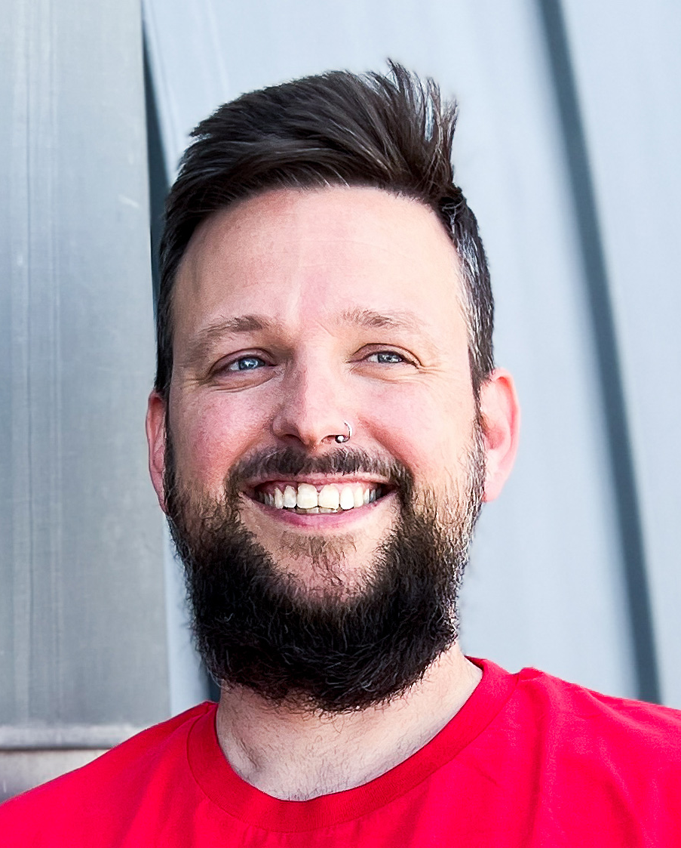
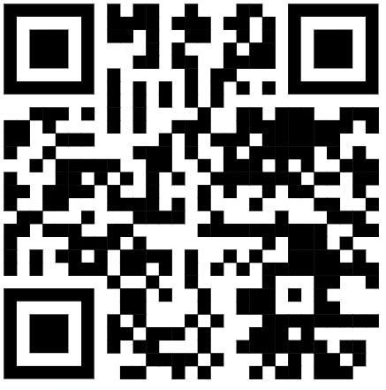
Christopher Brumm Cloud Security Architect @glueckkanja
Focus
Certifications
Identity + Security in Microsoft Cloud
ISC2 CISSP
Microsoft Security MVP
From
Hobbies
Hamburg, Germany
Family, Traveling, Pen & Paper RPG
My Blog
Contact
chris-brumm.com
/christopherbrumm

Slide 3
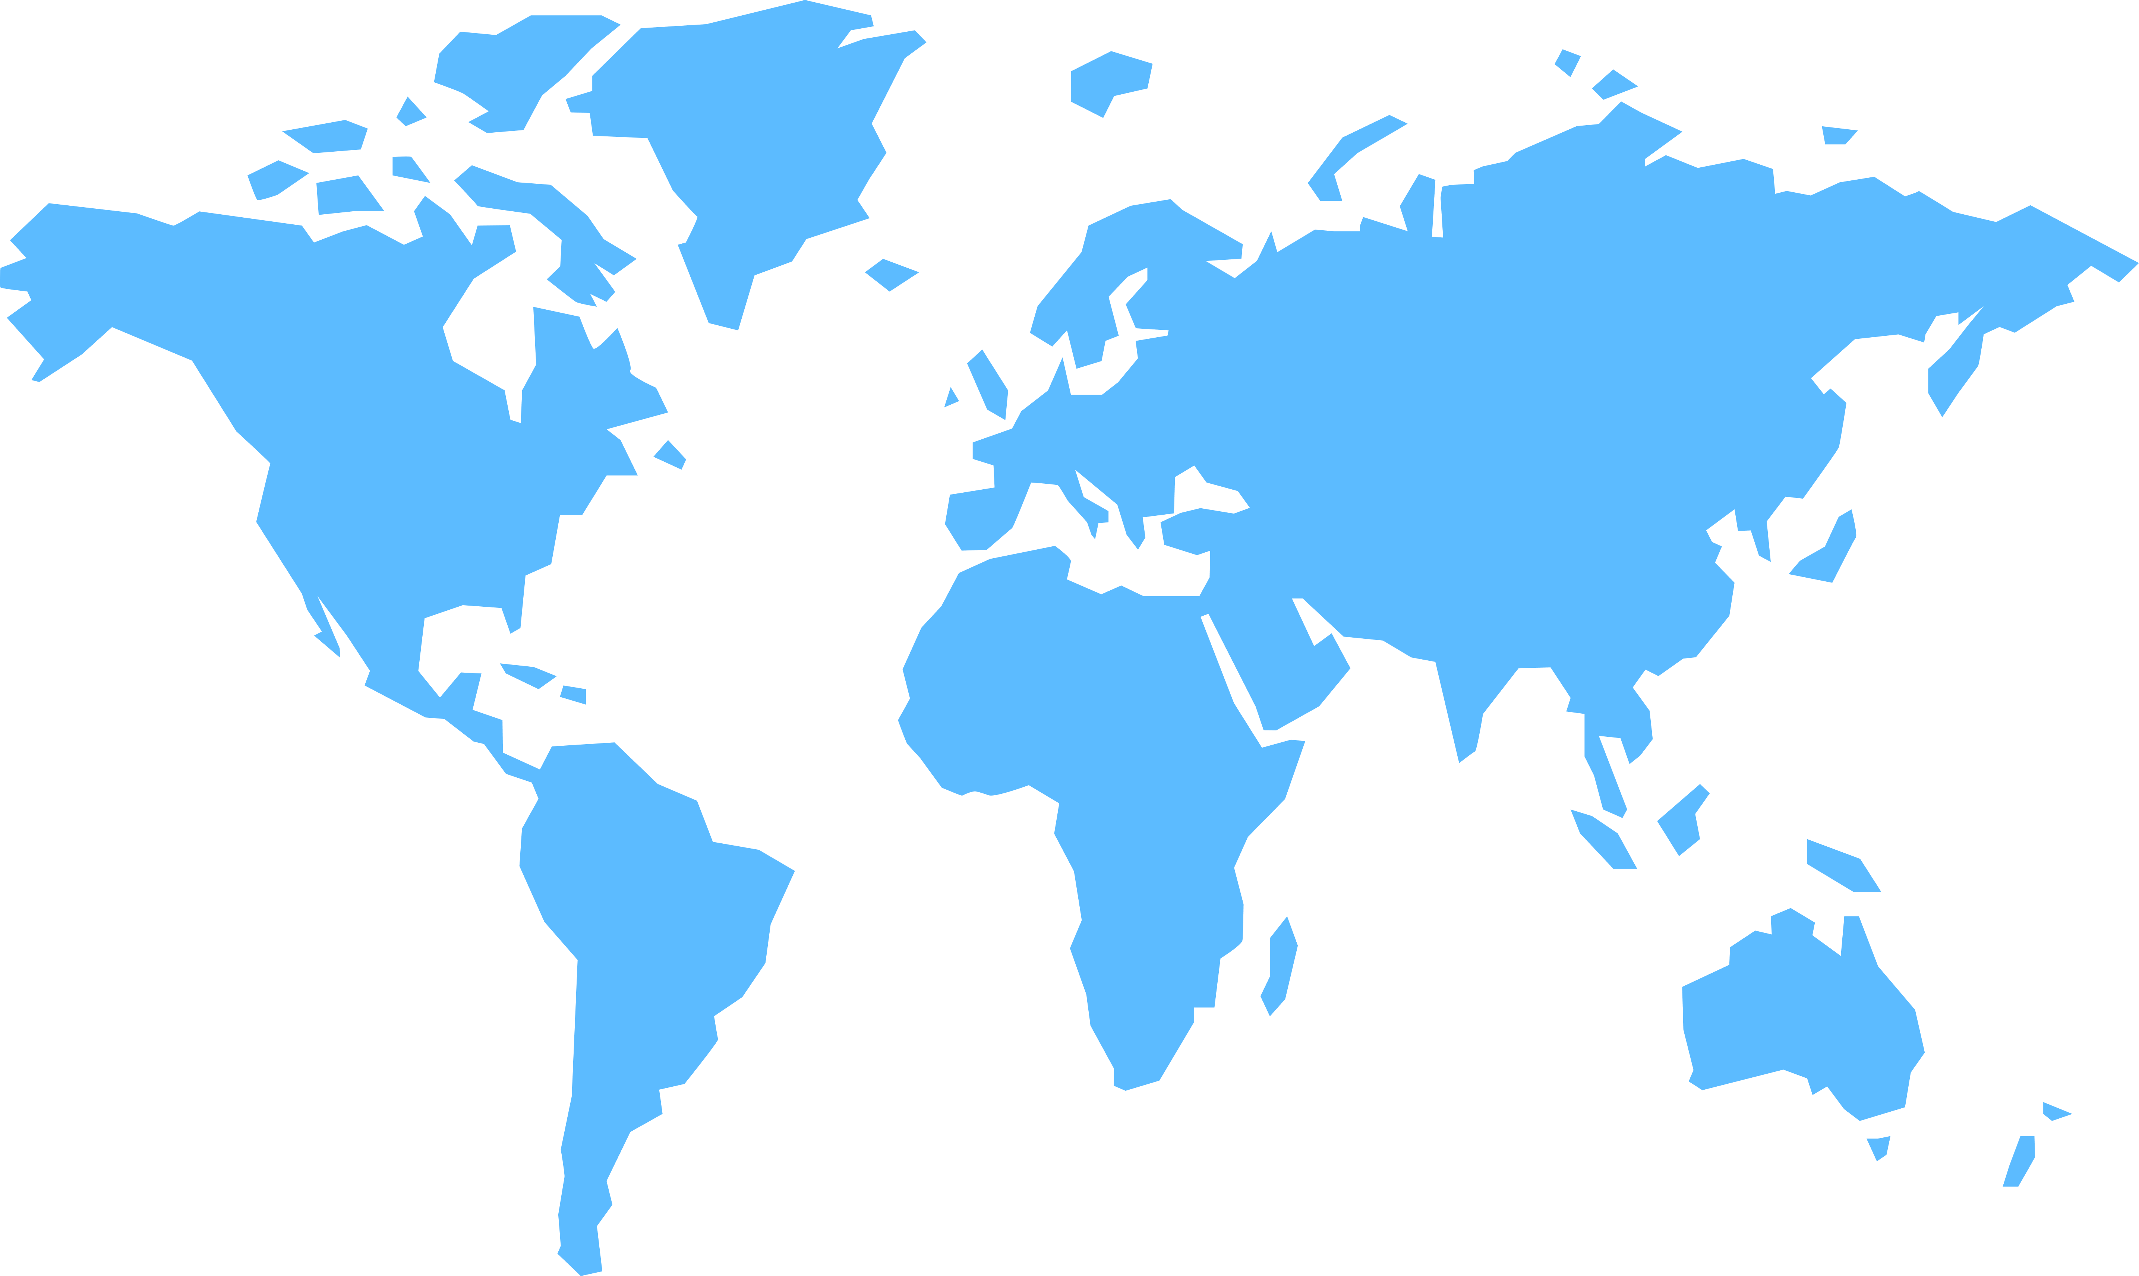
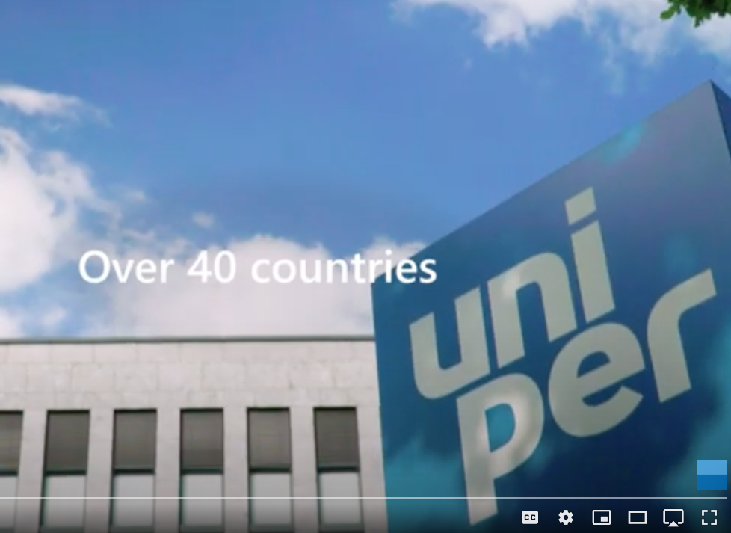
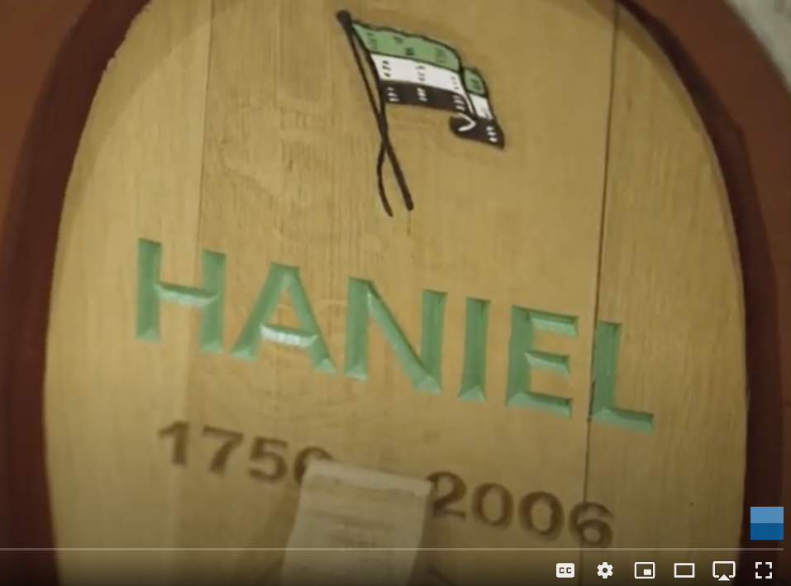
Protecting your assets around the globe 24/7
50+
Countries
5
Years in Service
15+
Industries

Slide 4
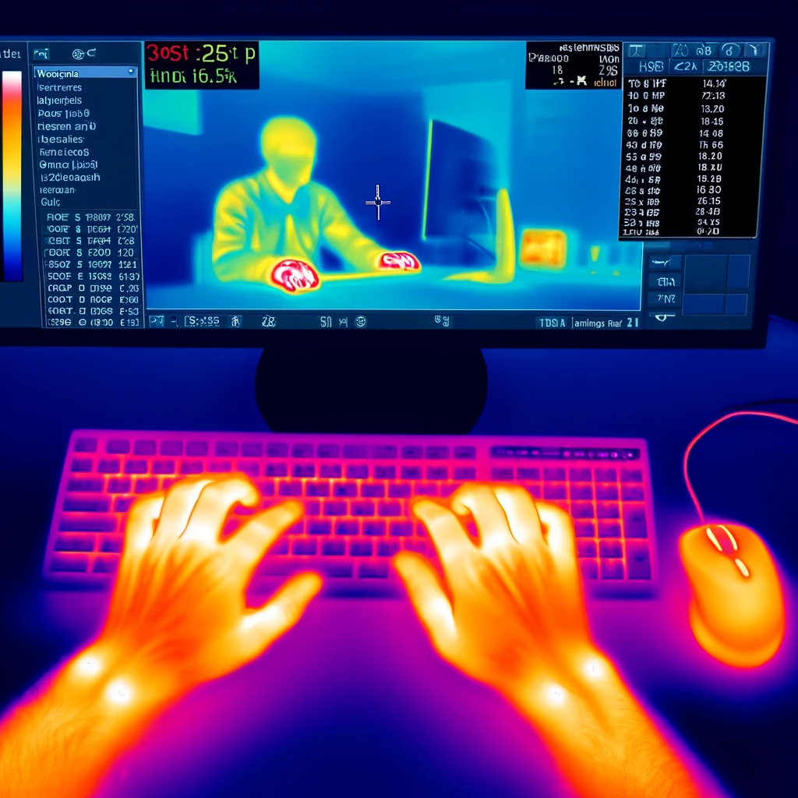
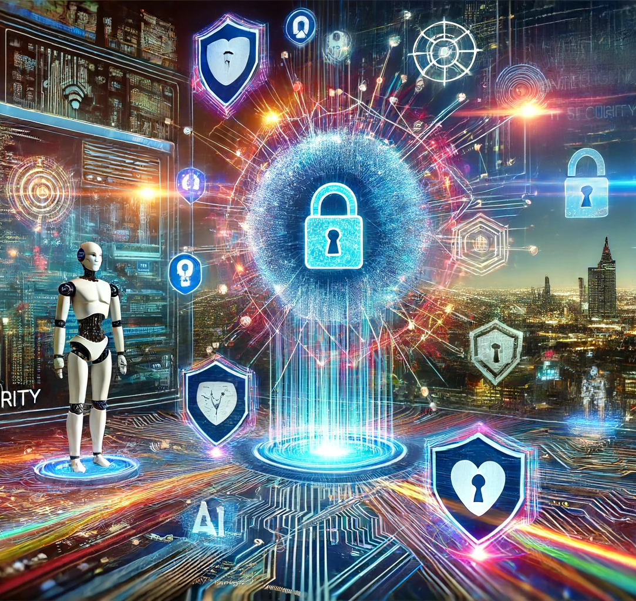
Thermal Attacks & AI supported Attacks

Slide 5
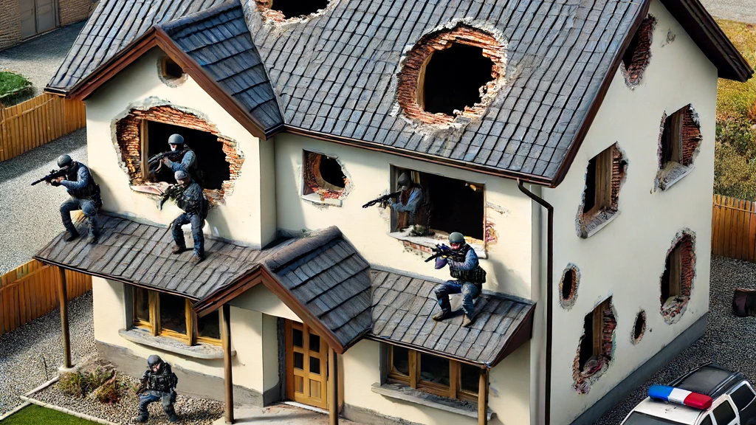

Slide 6
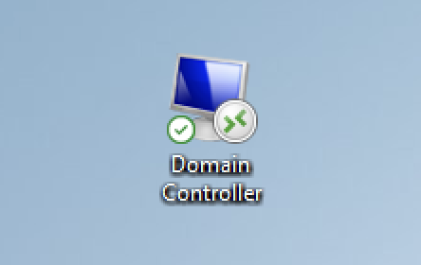
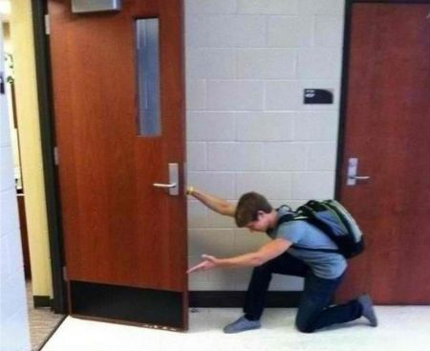
RDP
Bad Citrix Password, RDP File with saved creds on desktop.
Notes:
SQL Server Admin PW in Description Field im AD
FW Admin vergisst Laptop ohne Bitlocker Verschlüsselung im Zug. Darauf ist die FW Mgmt Konsole und ein paar Tage später beobachten wir seltsame Config Änderungen auf der FW

Slide 7
Adverts
User: Hey helpdesk, could you install a printer driver for me?
Ad • www.really-not-malicious.com
Official HP® Printer Drivers and Software Download Download the latest drivers, software, firmware, and diagnostics for your HP printers from the official HP Support website.

Slide 8
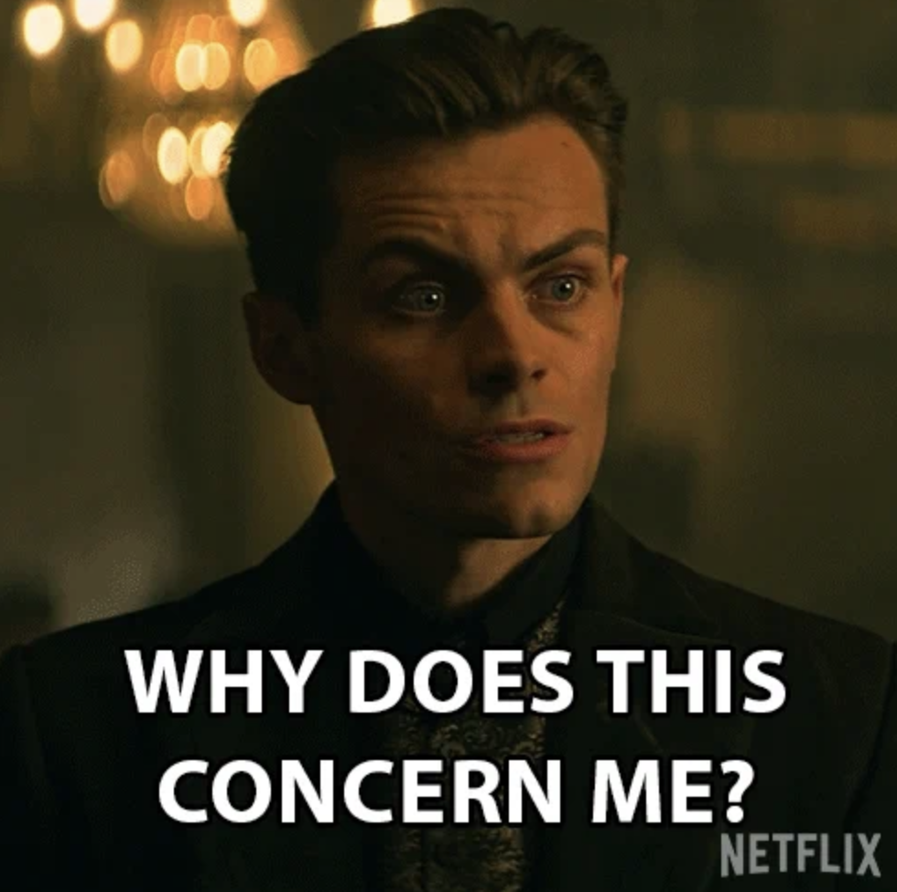
SQL Server
Service Provider on a Maintenance Saturday: Shit, I forgot to ask for the SQL Server Password
Hashcat

Slide 9
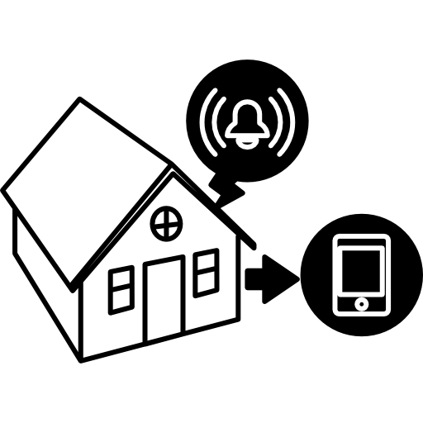
Are we safe enough?
The sorrows of a CISO
3
4
Will I recognize if someone tries to break in?
Can I stop an attacker?
2
Are there other ways into my house, I don‘t know about yet?
1
Are the obvious ways into my house well protected?

Slide 10
Enterprise Security Status
Are you safe?
1
Are the obvious ways into my house well protected?
2
Are there other ways into my house, I don‘t know about yet?
3
Will I recognize if someone tries to break in?
4
Can I stop an attacker?
Security Posture
Vulnerability Posture
Attack Monitoring
Capability
Incident Response
Capability
Infrastructure Architecture
Vulnerability Monitoring
XDR
Monitoring
24/7 IR Resources
As-Is Configuration
Quality
External Attack Surface Monitoring
Sentinel Monitoring
Preparation of Emergency Incident
Best Practices Feature Comparison
Pen Testing / Red Teaming
Maintained
Detection Repository
Processes

Slide 11
Applying it to your Org
Identity
Windows
MacOS
Linux
Email
Office
Network
DevOps
Cloud Platform
Cloud Workload
IoT
Business Apps
Security Posture
Vulnerability Posture
Attack Monitoring Capability
Incident Response Capability

Slide 12
Customer Maturity Levels (CML)
 | Security Posture | Vulnerability Posture | Attack Monitoring Capability | Incident Response Capability
CML 1 | USER MFA ASR Rules | Vulnerability Monitoring Critical Patch Workflow | MDE deployed on Clients MDI deployed | Internal or External SOC for Defender XDR
CML 2 | Role based just in time Access Pingcastle Result X | External Attack Surface Monitoring | Sentinel Maturity Level 1 | AzERE

Slide 13
Security Services
Notes:
We look at Security holistically:
Security Consulting
CSOC
APT Response
Preventive Services
AzERE
Managed Red Tenant

Slide 14
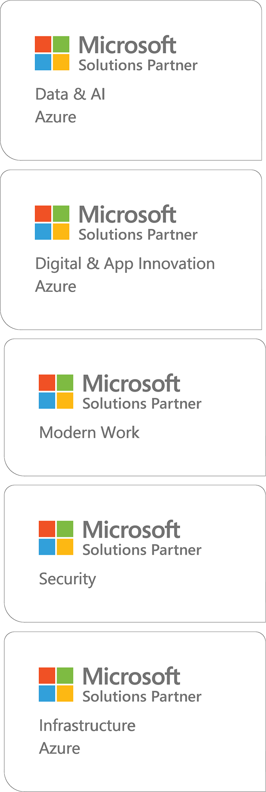
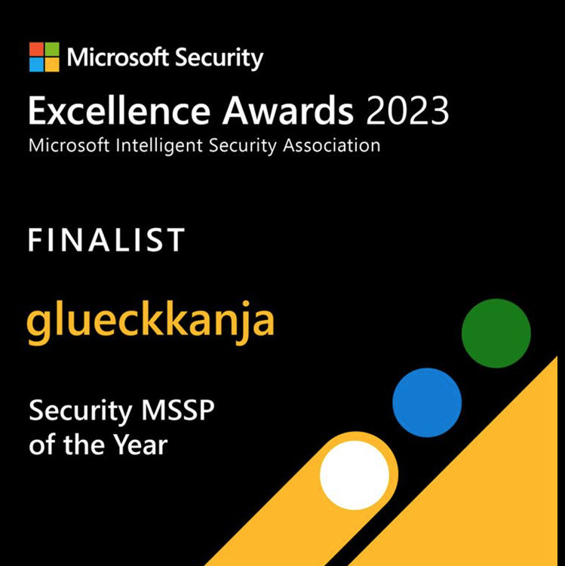
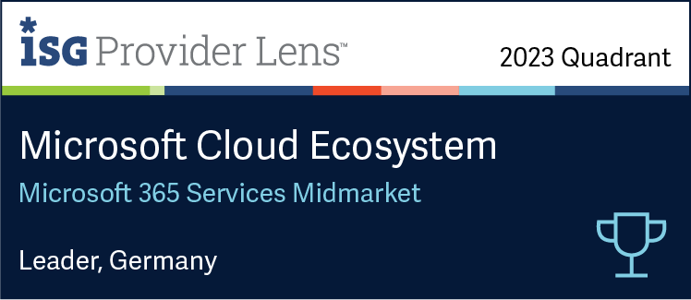
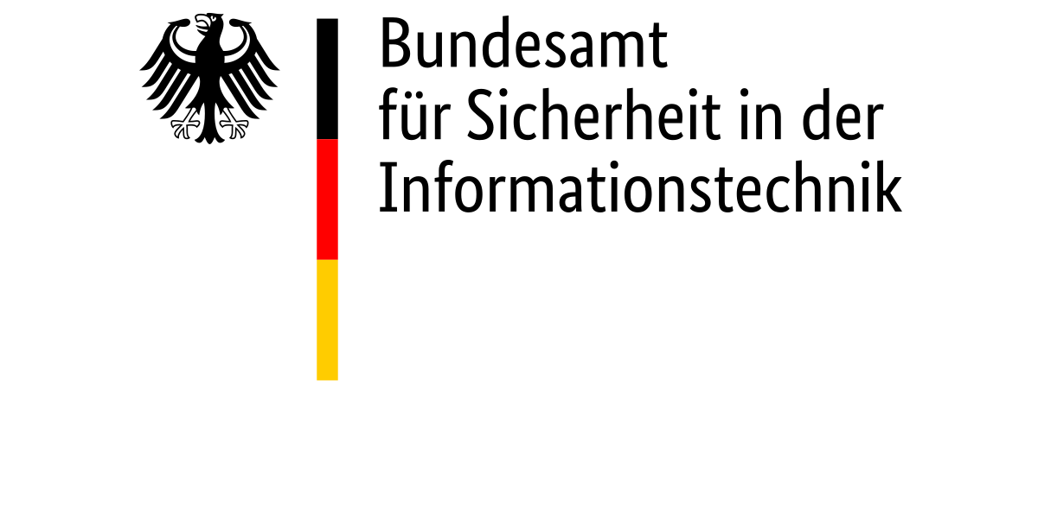
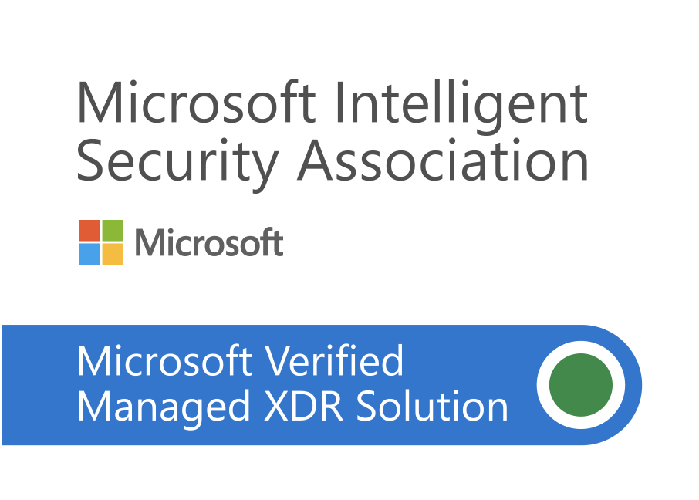
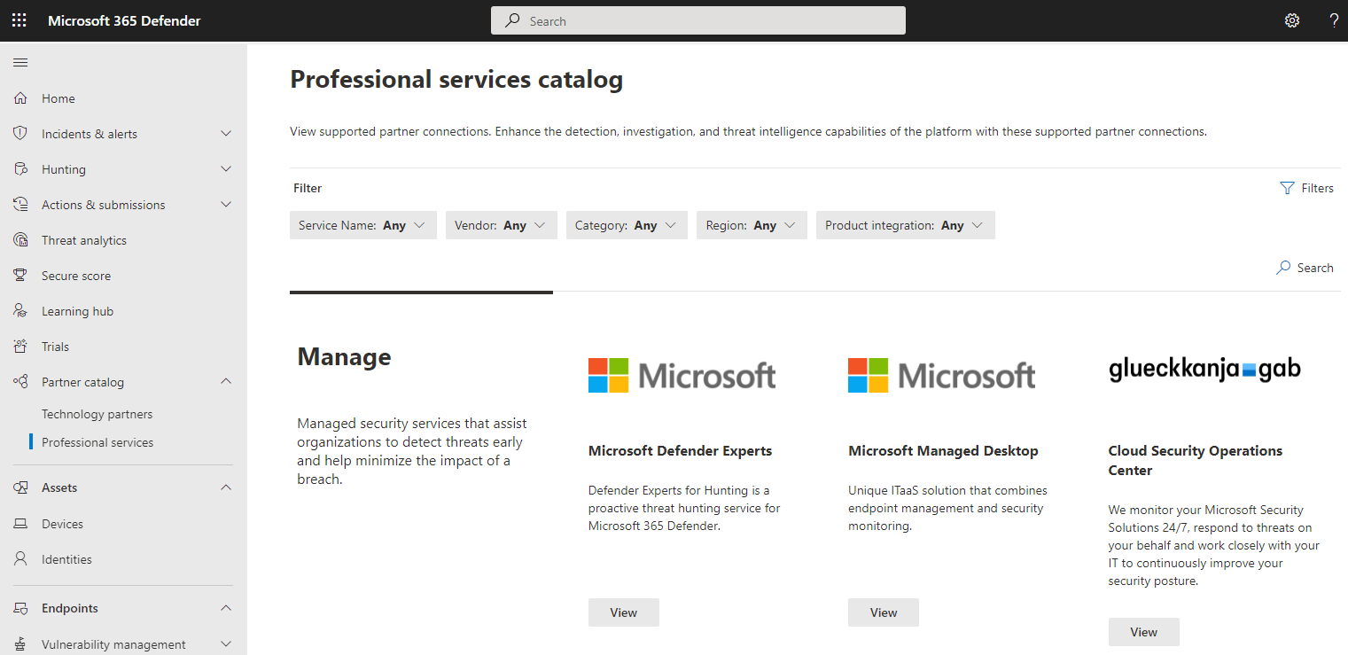
glueckkanja Microsoft
Qualifizierter APT Response Anbieter
Microsoft
Focus
Notes:
We earn these reputation, because we are protecting the most important companies in Europe
Due to our reputation we win all the Awards Microsoft is offering

Slide 15
Our Approach to Modern Security
Microsoft sponsored

Slide 16
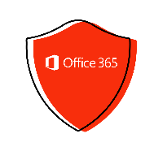
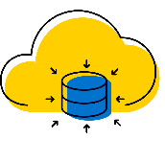
Asset Coverage
OT & IoT
On Premises
Cloud
Deep Packet Inspection (DPI) with patented, OT-aware behavioral analytics
Sensor (virtual or physical appliance)
Cloud Identity
Office 365
Devices
On Premises Identity
Entra ID
Devices
SPAN port
OT Network
Network switch
Documents
Dropbox
Google Cloud
Servers
Network
Amazon Web Services
Microsoft Azure
Defender for IoT
Defender for Endpoint
Defender for Office
Defender for Identity
Entra ID Protection
Defender for Cloud App
Defender for Cloud
Microsoft Sentinel

Slide 17
THANK YOU!

