Slide 1
APTs on the Rise:
Wie Hacker Smartphones ins Visier nehmen, um Unternehmensdaten zu kompromittieren

Slide 2
About Lookout
Mobile Heritage
Threat Intelligence
Protecting Cloud Data
Lookout is the technical leader and market leader in mobile security.
We discovered Pegasus in 2016 in collaboration with Citizen Labs.
We protect more than 220M+ devices with 320M+ apps in our security dataset.
Largest mobile threat intelligence team in the world.
Advanced machine learning and predictive analytics to identify and mitigate threats.
Analyzes mobile apps and mobile websites and correlates data from billions of data points.
Mobile is the most vulnerable point of compromise to access cloud data.
To protect cloud data, Lookout also provides secure services edge (SSE)
Helps protect data-at-rest and data-in-motion used on PC, mobile and cloud applications.
Notes:
Just a couple of words about Lookout
We are US-based cybersecurity company, founded in 2007
Mobile Heritage
If don't know us yet,
We were the first to publish a technical report about PEGASUS, the FAMOUS mobile spyware, which we exposed in a joint work with CitizenLabs in 2016.
So for us, this type of mobile spywares is very well known but
We are also tracking APT groups targeting mobile devices with malwares or phishing, we'll talk about that in a minute.
Today we protect more than 220M mobile devices (iOS, Android and Chromebooks)
And 500 000 enterprises, (from 5 devices to global enterprises with 300 000 devices)
Threat Intelligence
We have the largest threat intelligence team dedicated to mobile
Since this Pegasus discovery, our Treat Intelligence team has focused on the commercial spyware market
We have been able to identify and expose nearly a HUNDRED Advanced Powerful Spywares
used by nation states or APT groups to spy on people on their mobile phones.
Endpoint to Cloud Security
In addition to mobile security, Lookout also offers a Security Service Edge (SSE) platform that protects data wherever it goes
This platform provides visibility, control and security for DATA AT REST or
DATA IN MOTION between your endpoint (your mobile or your PC) and the cloud applications used by your employees.

Slide 3
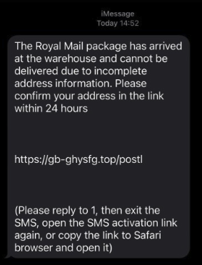
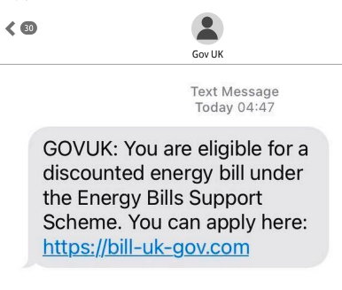
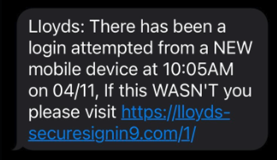
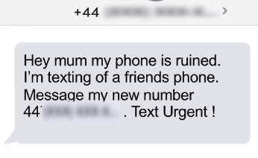
When you think of mobile attacks, what do you think of?
Broken phone scam
Parcel delivery
Energy scam
Banking scam
Notes:
What do you think of when you think of mobile attack?
Phishing, or Smishing, or QRCode Phishing, whatever you call it
It's on your mind because it's the thing you see the most on your own phone.
I'm sure you've all received at least one of these. whether you're using a corporate device or a personal device.
And you’re right, we just release our Q1 Mobile Threat Report, and mobile phishing is still the most important threat we see on mobile devices

Slide 4
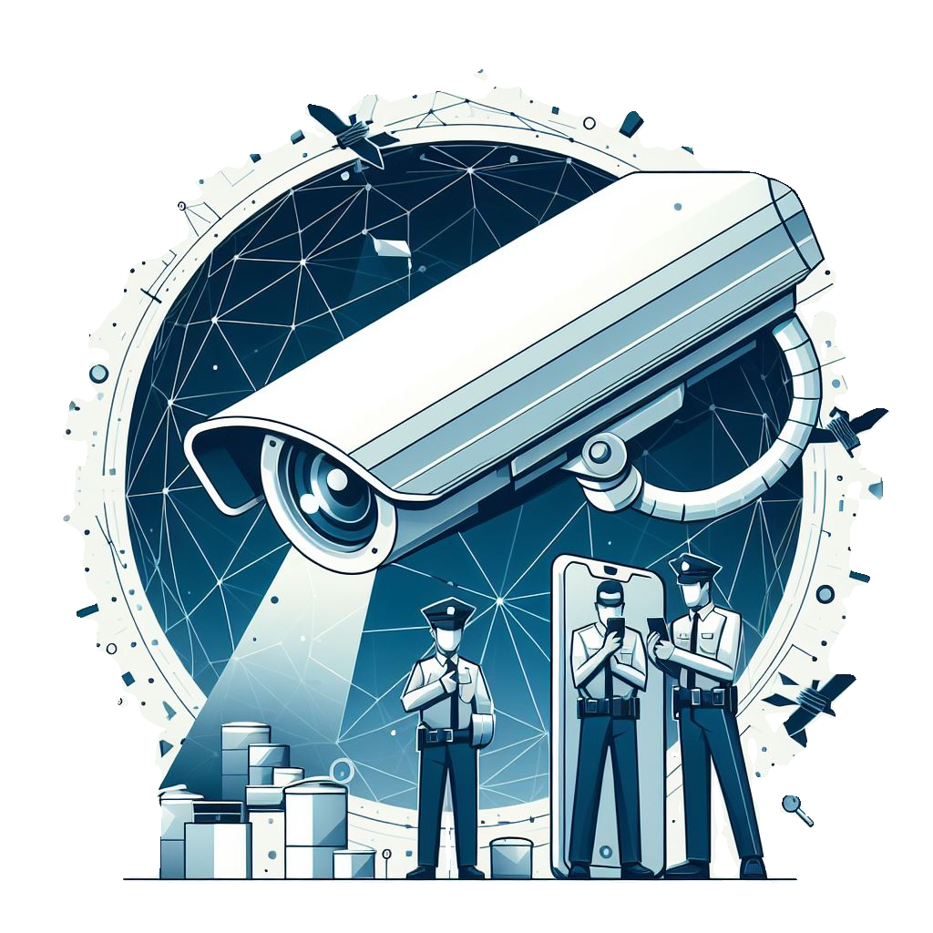
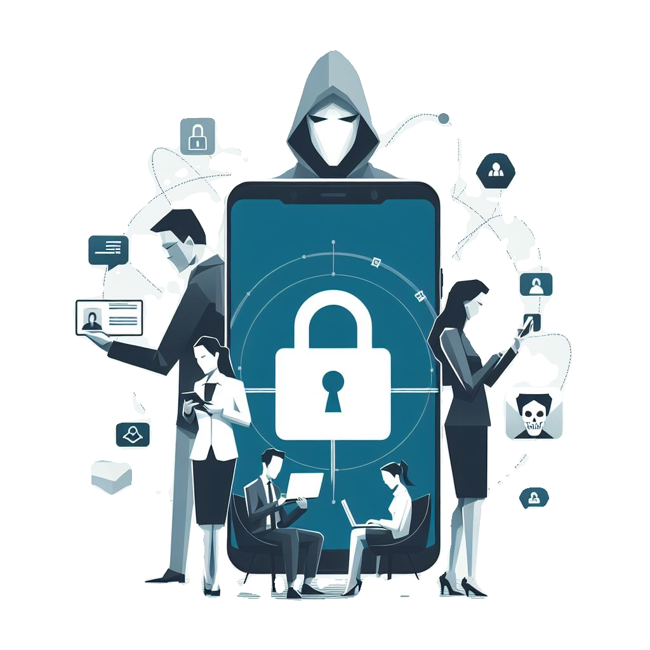
EVERYONE is targeting mobile devices...
Intelligence services
State-sponsored APT groups
Ransomware gangs
Scammers
Counter-terrorism
Fight against organised crime
Political influence
Espionage
Long-term persistence
Disruption and sabotage
Financial extortion
Data theft
Service disruption
Financial extortion
Theft of personal data
Identity theft
Notes:
EVERYONE !
Everyone is targeting mobile devices, and not only with Mobile PHISHING
Intelligence services, APT groups, Ransomware gangs, scammers
Every Threat Actor will use mobile devices to STEAL information from your employees:
Intelligence services will use a commercial surveillanceware vendor platform such as Predator, Hermit or Pegasus to exploit a vulnerability on your mobile device and remotely execute a SPYWARE on your mobile device.
State-sponsored APT groups will use various techniques to remotely install a SPYWARE, TROJAN or BACKDOOR on your phone
And Ransomware gangs will use your mobile device as an entry point to infiltrate your CORPORATE network, usually using spear phishing sent via iMessage, SMS or other instant messaging applications
And, of course, the scammers will send you the SMS you may have already received. They will try to steal a few pounds from the elderly or naive.
So EVERYONE is targeting your employees' mobile devices, but if you don't have the right level of protection, you won't see a thing!

Slide 5
Commercial Surveillanceware Vendors
80 countries, including 14 European countries, use Pegasus or another CSV
Pegasus
Hermit
Predator
DevilsTongue
Packetlogic (Injector)
Intelligence services
NSO Group
Cy4Gate
Intellexa
Candiru
Sandvine
Tactics Used
Multiple 0-day vulnerability exploitation (0-click or 1-click)
Drive-by download
Graphite
Skygofree
Krait
Heliconia
Invisible Man
Paragon
Negg Group
Memento Labs
Variston
Mollitiam Industries
Notes:
14 of the 27 countries in the European Union have purchased spyware from just one vendor, the NSO Group
Out of 195 countries in the world, at least 80 are known to have procured spyware from commercial vendors.
https://dfrlab.org/2024/09/04/mythical-beasts-and-where-to-find-them-report/
Spyware vendors were attributed to 50% of all 0-day exploits discovered by one company’s threat research team in 2023, including 64% of all exploits in mobile and browser software.
Useful links : https://www.europarl.europa.eu/meetdocs/2014_2019/plmrep/COMMITTEES/PEGA/PR/2023/05-08/1267987EN.pdf https://www.issworldtraining.com/iss_europe/sponsors.html
Use this DB as public reference if somebody ask about infection example : https://data.mendeley.com/datasets/csvhpkt8tm/10

Slide 6
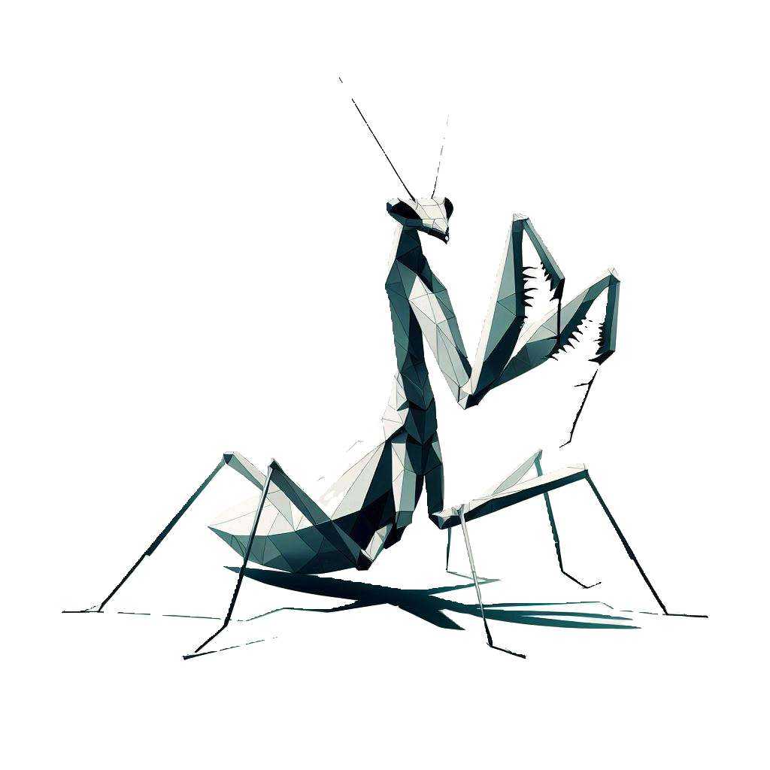
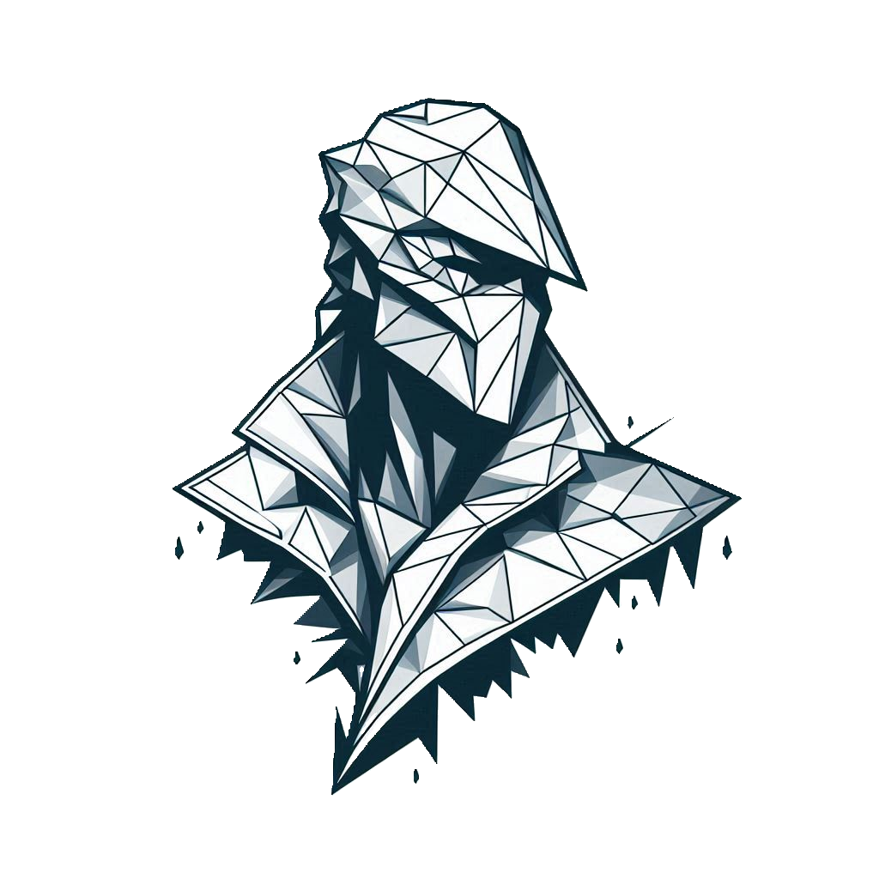
Nation-State APT groups
Targeting mobile devices with exploit, spear phishing or malware
Roaming Mantis
APT41
APT15
Bahamut
Lazaru$
State-sponsored APT groups
China
China
China
Middle East
North Korea
Tactics Used
Watering Hole Attacks + 0-day
Direct Message Spear phishing
Trojanized Popular Apps
Oilrig / APT34
Sandworm / APT44
Gamaredon
Cozy Bear / APT29
InkySquid / APT37
Iran
Russia
Russia
Russia
North Korea
Notes:
If we look at the APT groups that are targeting mobile devices in preparation for a large-scale attack
We see different groups, from different countries
…
and these groups don’t focus only on mobile, they use your mobile device as an entry point
with mobile phishing or with mobile malwares
To infiltrate any organization.

Slide 7
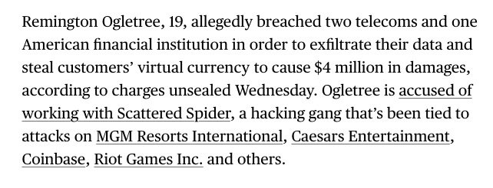
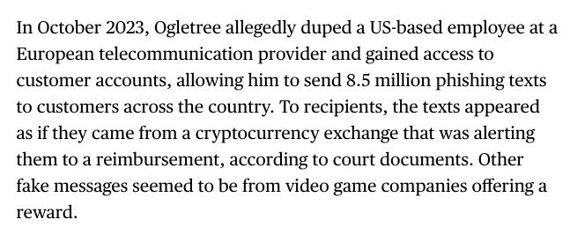
Ransomware Gangs
Using mobile devices as an entry point to infiltrate organisations
Ransomware gangs
Tactics Used
Spear Phishing
Credentials harvesting
Supply Chain attacks

Slide 8
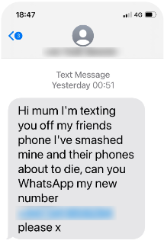
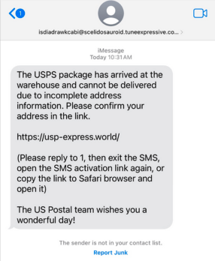
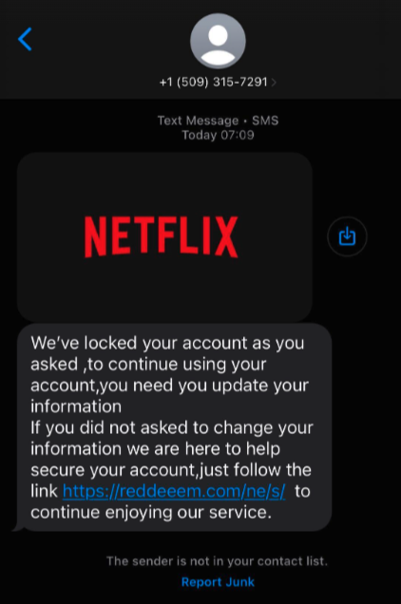
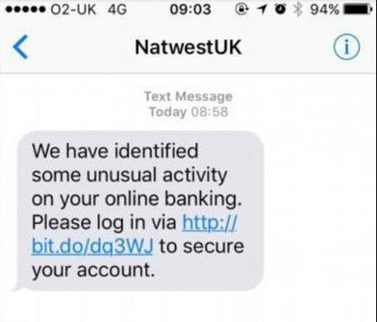
Scammers
Send fake texts to steal personal information and money
Scammers
Tactics Used
Mass Phishing
Personal data harvesting
Account takeover
Broken Phone Scam
Parcel Delivery Scam
Account Locked Scam
Banking Scam

Slide 9
The evolution of mobile spyware
Lookout has discovered more than 1200 spywares including 140+ families made by Commercial Surveillance Vendors or APT groups
Pegasus
2016
Massive abuse of Commercial Surveillance software to spy on private citizens NSO Group sold Pegasus to 14 European governments
Techniques used by “CSVs” and “APT groups” are becoming more and more similar Using 0-click or 1-click exploits or tricking the user to execute or install spyware on mobile devices
Chrysaor
2017
Dark Caracal
2018
GuardZoo
2024
Stealth Mango
2018
Monokle
2019
Double
Agent
2020
Sunbird & Hornbill
2021
Predator*
2021
Hermit
2022
BadBazaar
2022
BouldSpy
2023
Deblind
2023
* Predator has been detected by Citizen Lab
Notes:
Pegasus : Israel
Chrysaor (Android version of Pegasus) : Israel
Dark Caracal : Libanon => Military and gov in Kazakhstan
Stealth Mango : Pakistan => victims in Pakistan, Afghanistan, India, Iraq, Iran,and the UAE
Monokle : Russia iOS RAT made by STC target individuals in the Caucasus regions and individuals interested in the a militant group in Syria
Double Agent : China => Targeting Uyghurs
Sunbirn & Hornbill : India => Pakistani officials
Predator (discovered by Citizen Labs and not by Lookout) : North Macedonia but Cytrox has been created by Israelian
Hermit : Italy
BadBazaar : China => Targeting Uyghurs
BoulSpy : Iranian police targeting Iranian Kurds
Deblind : Russia => Targeting Ukrainian
GuardZoo : Yemen => Middle East Military Organizations

Slide 10
The evolution of mobile spyware
Lookout has discovered more than 1200 spywares including 140+ families made by Commercial Surveillance Vendors or APT groups
Pegasus
2016
Country of Origin: Israel
Still Active: Yes
Activity: First exposed in 2016, active since at least 2014.
Created by: NSO Group (CSV)
Data Exfiltrated: Messages (SMS, email, encrypted messages), call logs, contacts, browser history, location data, audio/video recordings.
Targets: Journalists, political activists, human rights defenders, government officials.
Main Deployment Tactics: Spear-phishing (SMS, email), zero-click exploits (e.g., iMessage, WhatsApp), remote vulnerability exploitation.
Chrysaor
2017
Dark Caracal
2018
GuardZoo
2024
Stealth Mango
2018
Monokle
2019
Double
Agent
2020
Sunbird & Hornbill
2021
Predator*
2021
Hermit
2022
BadBazaar
2022
BouldSpy
2023
Deblind
2023
* Predator has been detected by Citizen Lab
Notes:
Pegasus : Israel
Chrysaor (Android version of Pegasus) : Israel
Dark Caracal : Libanon => Military and gov in Kazakhstan
Stealth Mango : Pakistan => victims in Pakistan, Afghanistan, India, Iraq, Iran,and the UAE
Monokle : Russia iOS RAT made by STC target individuals in the Caucasus regions and individuals interested in the a militant group in Syria
Double Agent : China => Targeting Uyghurs
Sunbirn & Hornbill : India => Pakistani officials
Predator (discovered by Citizen Labs and not by Lookout) : North Macedonia but Cytrox has been created by Israelian
Hermit : Italy
BadBazaar : China => Targeting Uyghurs
BoulSpy : Iranian police targeting Iranian Kurds
Deblind : Russia => Targeting Ukrainian
GuardZoo : Yemen => Middle East Military Organizations

Slide 11
The evolution of mobile spyware
Lookout has discovered more than 1200 spywares including 140+ families made by Commercial Surveillance Vendors or APT groups
Pegasus
2016
Country of Origin: Italy
Still Active: Yes
Activity: First discovered in 2022, active since 2019
Created by: RCS Labs (CSV)
Data Exfiltrated: Call logs, text messages, emails, photos, browser data, keystrokes.
Targets: Journalists, activists, politicians in Italy and Turkey, as well as globally.
Main Deployment Tactics: Fake telecom apps, SMS-based phishing, vulnerabilities in mobile apps or Android devices.
Chrysaor
2017
Dark Caracal
2018
GuardZoo
2024
Stealth Mango
2018
Monokle
2019
Double
Agent
2020
Sunbird & Hornbill
2021
Predator*
2021
Hermit
2022
BadBazaar
2022
BouldSpy
2023
Deblind
2023
* Predator has been detected by Citizen Lab
Notes:
Pegasus : Israel
Chrysaor (Android version of Pegasus) : Israel
Dark Caracal : Libanon => Military and gov in Kazakhstan
Stealth Mango : Pakistan => victims in Pakistan, Afghanistan, India, Iraq, Iran,and the UAE
Monokle : Russia iOS RAT made by STC target individuals in the Caucasus regions and individuals interested in the a militant group in Syria
Double Agent : China => Targeting Uyghurs
Sunbirn & Hornbill : India => Pakistani officials
Predator (discovered by Citizen Labs and not by Lookout) : North Macedonia but Cytrox has been created by Israelian
Hermit : Italy
BadBazaar : China => Targeting Uyghurs
BoulSpy : Iranian police targeting Iranian Kurds
Deblind : Russia => Targeting Ukrainian
GuardZoo : Yemen => Middle East Military Organizations

Slide 12
The evolution of mobile spyware
Lookout has discovered more than 1200 spywares including 140+ families made by Commercial Surveillance Vendors or APT groups
Pegasus
2016
Country of Origin: China
Still Active: Yes
Activity: First discovered in 2021.
Created by: APT15, tied to Chinese government
Data Exfiltrated: Call logs, contacts, location, device information.
Targets: Ethnic minorities, especially Tibetans, Uyghurs and Taiwanese.
Main Deployment Tactics: Trojanized iOS and Android apps posing as VPN or messaging apps.
Chrysaor
2017
Dark Caracal
2018
GuardZoo
2024
Stealth Mango
2018
Monokle
2019
Double
Agent
2020
Sunbird & Hornbill
2021
Predator*
2021
Hermit
2022
BadBazaar
2022
BouldSpy
2023
Deblind
2023
* Predator has been detected by Citizen Lab
Notes:
Pegasus : Israel
Chrysaor (Android version of Pegasus) : Israel
Dark Caracal : Libanon => Military and gov in Kazakhstan
Stealth Mango : Pakistan => victims in Pakistan, Afghanistan, India, Iraq, Iran,and the UAE
Monokle : Russia iOS RAT made by STC target individuals in the Caucasus regions and individuals interested in the a militant group in Syria
Double Agent : China => Targeting Uyghurs
Sunbirn & Hornbill : India => Pakistani officials
Predator (discovered by Citizen Labs and not by Lookout) : North Macedonia but Cytrox has been created by Israelian
Hermit : Italy
BadBazaar : China => Targeting Uyghurs
BoulSpy : Iranian police targeting Iranian Kurds
Deblind : Russia => Targeting Ukrainian
GuardZoo : Yemen => Middle East Military Organizations

Slide 13
The evolution of mobile spyware
Lookout has discovered more than 1200 spywares including 140+ families made by Commercial Surveillance Vendors or APT groups
Pegasus
2016
Country of Origin: Iran
Still Active: Yes
Activity: Discovered in 2023.
Created by: Faraja (Iranian national law enforcement)
Data Exfiltrated: Messages, call logs, contacts, GPS data.
Targets: Government & military officials, activists in South Asia.
Main Deployment Tactics: Trojanized apps, spear-phishing, fake productivity tools.
Chrysaor
2017
Dark Caracal
2018
GuardZoo
2024
Stealth Mango
2018
Monokle
2019
Double
Agent
2020
Sunbird & Hornbill
2021
Predator*
2021
Hermit
2022
BadBazaar
2022
BouldSpy
2023
Deblind
2023
* Predator has been detected by Citizen Lab
Notes:
Pegasus : Israel
Chrysaor (Android version of Pegasus) : Israel
Dark Caracal : Libanon => Military and gov in Kazakhstan
Stealth Mango : Pakistan => victims in Pakistan, Afghanistan, India, Iraq, Iran,and the UAE
Monokle : Russia iOS RAT made by STC target individuals in the Caucasus regions and individuals interested in the a militant group in Syria
Double Agent : China => Targeting Uyghurs
Sunbirn & Hornbill : India => Pakistani officials
Predator (discovered by Citizen Labs and not by Lookout) : North Macedonia but Cytrox has been created by Israelian
Hermit : Italy
BadBazaar : China => Targeting Uyghurs
BoulSpy : Iranian police targeting Iranian Kurds
Deblind : Russia => Targeting Ukrainian
GuardZoo : Yemen => Middle East Military Organizations

Slide 14
The evolution of mobile spyware
Lookout has discovered more than 1200 spywares including 140+ families made by Commercial Surveillance Vendors or APT groups
Pegasus
2016
Country of Origin: Russia
Still Active: Likely active
Activity: First reported in 2020.
Created by: APT44 (SandWorm) ties to Russian government
Data Exfiltrated: Messages, calls, photos, location.
Targets: Ukrainian military
Main Deployment Tactics: Fake apps, phishing, mobile exploit chains.
Chrysaor
2017
Dark Caracal
2018
GuardZoo
2024
Stealth Mango
2018
Monokle
2019
Double
Agent
2020
Sunbird & Hornbill
2021
Predator*
2021
Hermit
2022
BadBazaar
2022
BouldSpy
2023
Deblind
2023
* Predator has been detected by Citizen Lab
Notes:
Pegasus : Israel
Chrysaor (Android version of Pegasus) : Israel
Dark Caracal : Libanon => Military and gov in Kazakhstan
Stealth Mango : Pakistan => victims in Pakistan, Afghanistan, India, Iraq, Iran,and the UAE
Monokle : Russia iOS RAT made by STC target individuals in the Caucasus regions and individuals interested in the a militant group in Syria
Double Agent : China => Targeting Uyghurs
Sunbirn & Hornbill : India => Pakistani officials
Predator (discovered by Citizen Labs and not by Lookout) : North Macedonia but Cytrox has been created by Israelian
Hermit : Italy
BadBazaar : China => Targeting Uyghurs
BoulSpy : Iranian police targeting Iranian Kurds
Deblind : Russia => Targeting Ukrainian
GuardZoo : Yemen => Middle East Military Organizations

Slide 15
The evolution of mobile spyware
Lookout has discovered more than 1200 spywares including 140+ families made by Commercial Surveillance Vendors or APT groups
Pegasus
2016
Country of Origin: Yemen
Still Active: Yes
Activity: Discovered in 2019, still active in 2024
Created by: a Yemeni, Houthi-aligned group
Data Exfiltrated: Messages, call logs, contacts, GPS data.
Targets: military personnel from Middle Eastern countries
Main Deployment Tactics: Fake apps, backdoors.
Chrysaor
2017
Dark Caracal
2018
GuardZoo
2024
Stealth Mango
2018
Monokle
2019
Double
Agent
2020
Sunbird & Hornbill
2021
Predator*
2021
Hermit
2022
BadBazaar
2022
BouldSpy
2023
Deblind
2023
* Predator has been detected by Citizen Lab
Notes:
Pegasus : Israel
Chrysaor (Android version of Pegasus) : Israel
Dark Caracal : Libanon => Military and gov in Kazakhstan
Stealth Mango : Pakistan => victims in Pakistan, Afghanistan, India, Iraq, Iran,and the UAE
Monokle : Russia iOS RAT made by STC target individuals in the Caucasus regions and individuals interested in the a militant group in Syria
Double Agent : China => Targeting Uyghurs
Sunbirn & Hornbill : India => Pakistani officials
Predator (discovered by Citizen Labs and not by Lookout) : North Macedonia but Cytrox has been created by Israelian
Hermit : Italy
BadBazaar : China => Targeting Uyghurs
BoulSpy : Iranian police targeting Iranian Kurds
Deblind : Russia => Targeting Ukrainian
GuardZoo : Yemen => Middle East Military Organizations

Slide 16
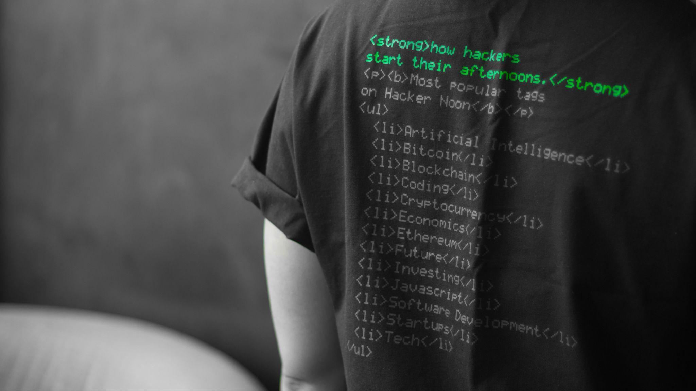
Social Engineering
Spearphishing
Deception
Physical Access

Slide 17
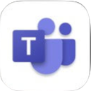
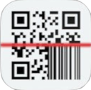
Understanding Mobile Risk
Potential entry points
WEB & CONTENT
APPS
DEVICE
NETWORK
Phishing
QR Codes
Malicious sites
Offensive sites
Restricted sites
App malware
MFA tokens
Leaky apps
Non compliance
Personal apps
Outdated OS
Rooted device
Mis configuration
USB debugging
Android patches
Unsafe WiFi
Public hotspots
Man-in-the-middle
Wireless Access Points
DNS injection

Slide 18
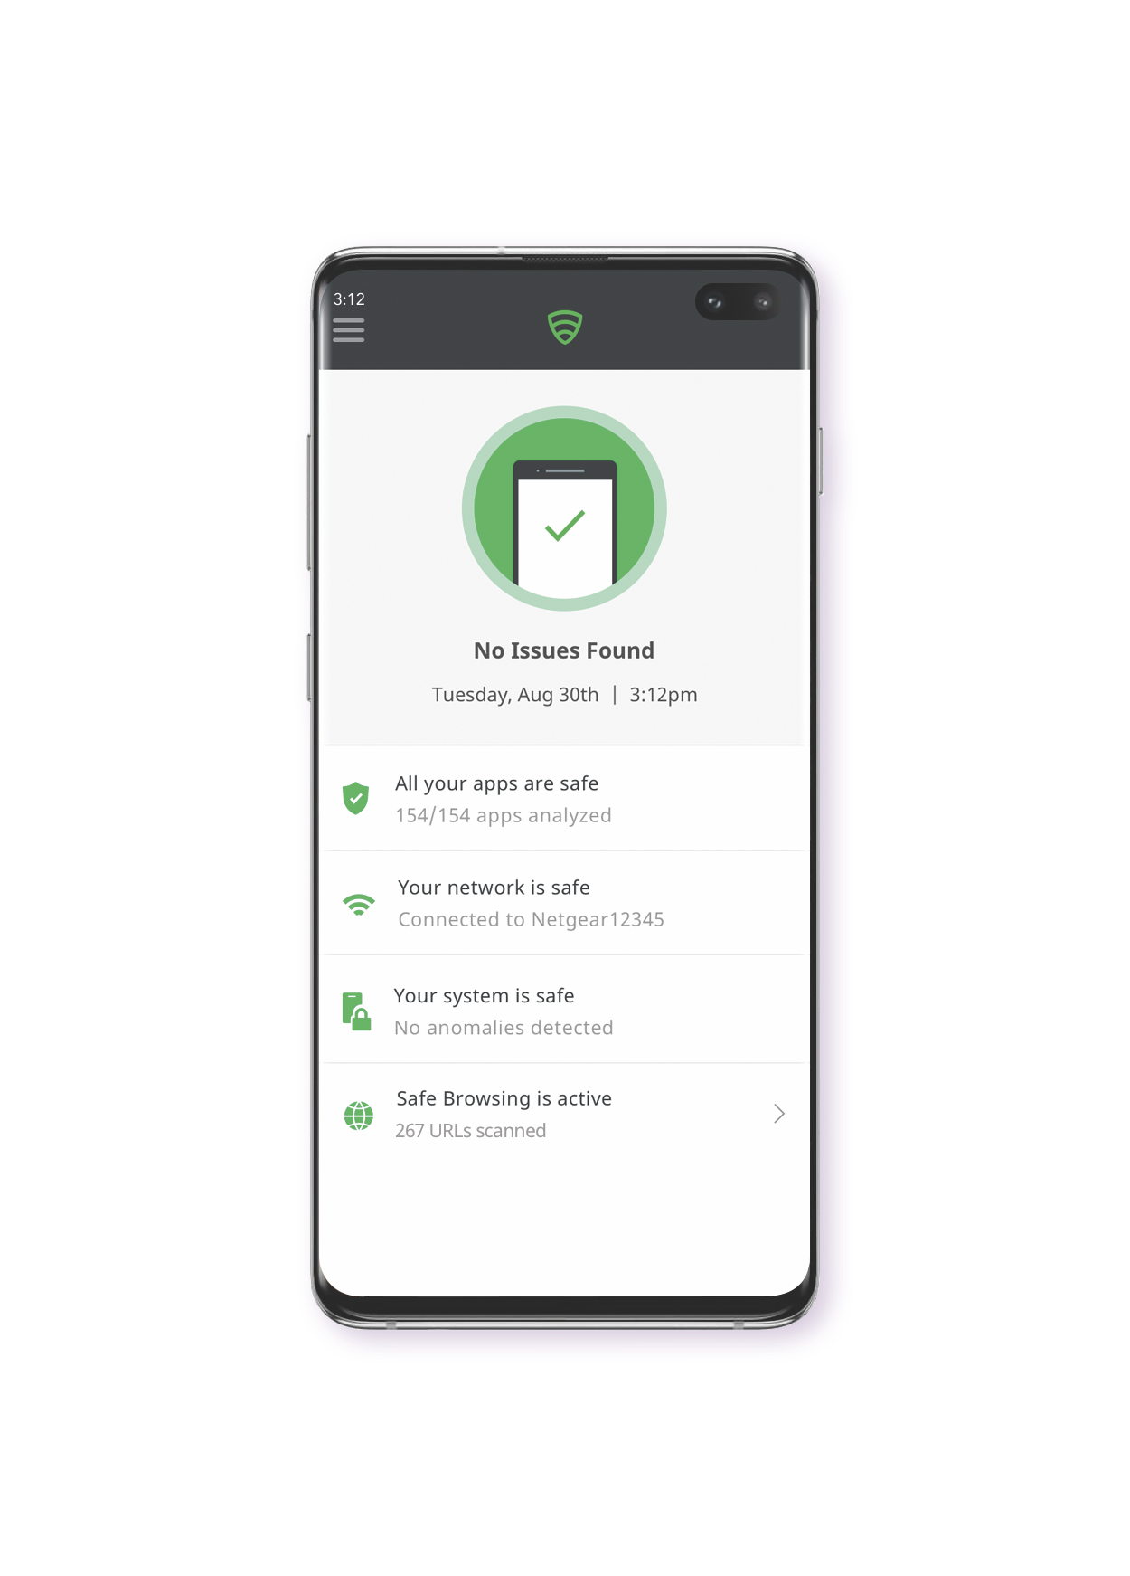
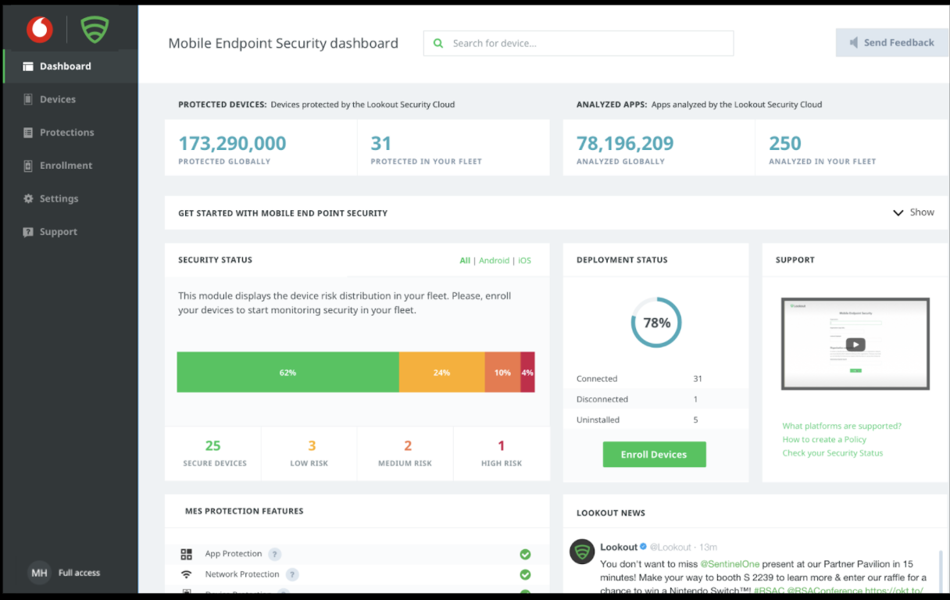
Lookout Mobile Security
Overview
Admins
Control deployment
Mobile risk visibility
Configure policies
Emailed notifications
End users
Mobile health assessed
Real time threat alerts
95% self remediation
Privacy maintained

Slide 19
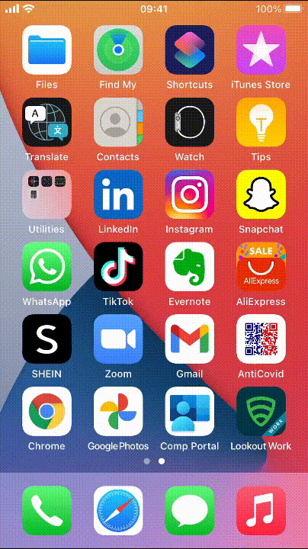
Phishing detection
User experience demo
> By default each user is blocked from visiting websites which are detected as phishing content
> Issue is self remediated without needing any end user or admin interaction
> The phishing protection policy can be adjusted in the Lookout console to instead warn device / user
> Lookout also allows content filtering from mobile to restrict certain web content categories

Slide 20
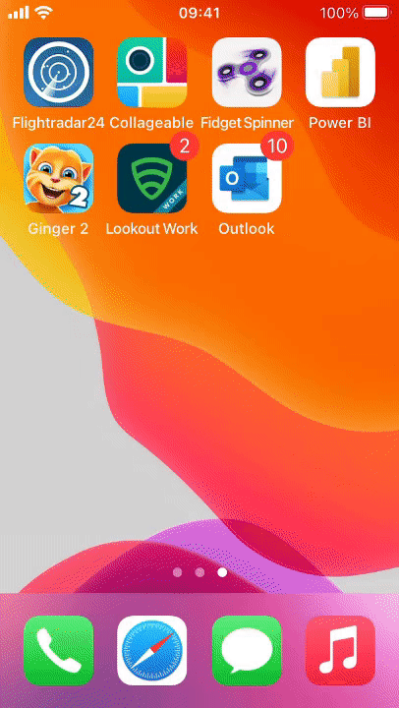
App malware detection
User experience demo
> Apps are a common way to disguise the delivery of malware such as spyware, trojans or riskware
> The user is provided with simple remediation steps to remove the apps containing riskware
> The admin can set policies to block the user from accessing content until the apps are removed
> Lookout Advanced allows an admin to create a list of denylisted apps or app versions

Slide 21
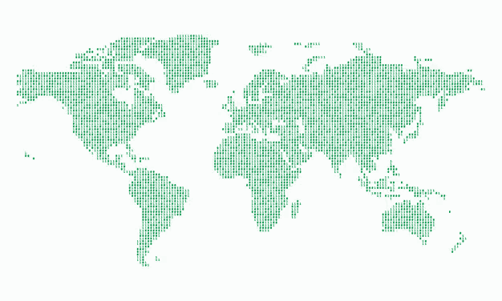
Why Lookout?
The recognised market leader in mobile security
Mobile-first security. specialising in protecting iOS, Android & Chrome OS devices
Advanced machine learning and predictive analytics is used to identify and mitigate threats
The Lookout Security Graph analyses app behaviour and correlates data from billions of data points to detect new and emerging threats
Enterprise grade security delivered in a simple intuitive user experience tailored to SMBs

Slide 22
Thank You
Want to learn more?
Visit us at Stand A42 to claim your free Lookout for Work license.

